Slide 1
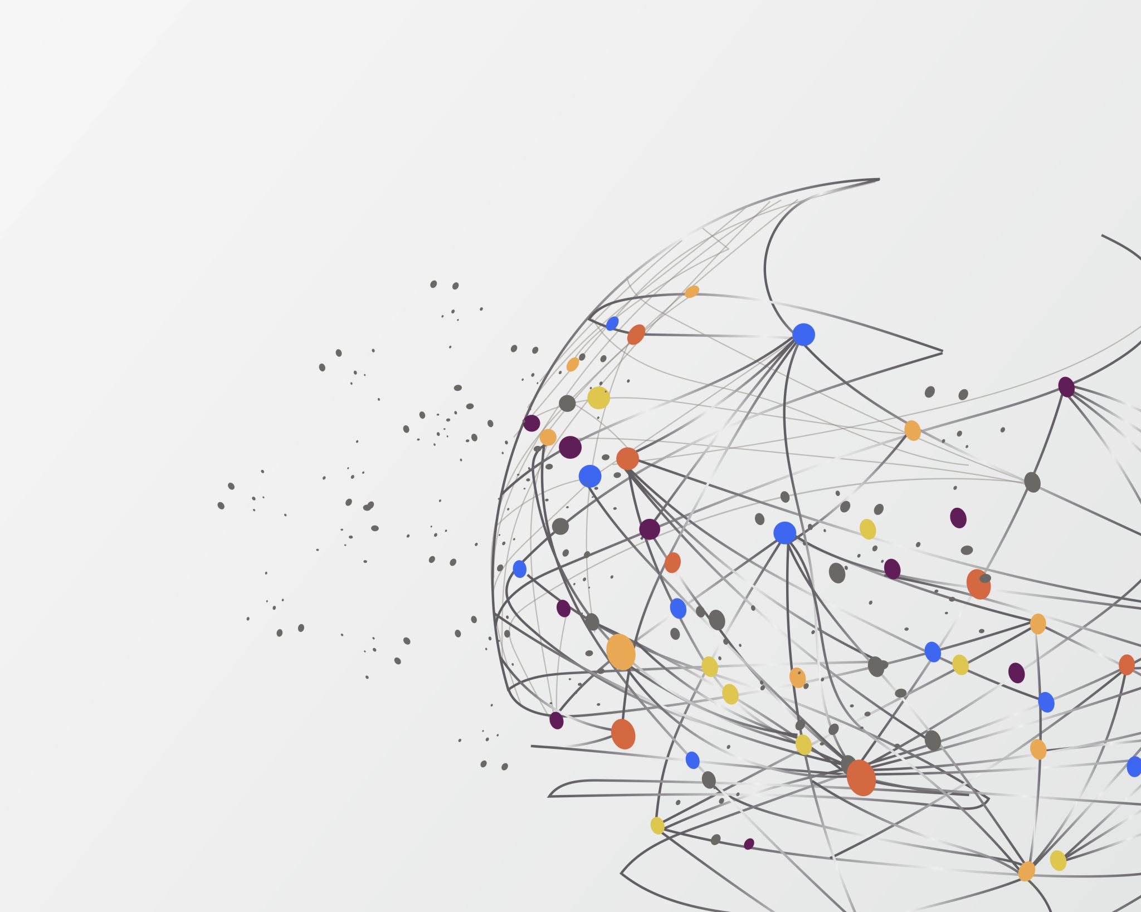
PowerShell Task 1 Peer Programming
PRESENTING:
CISv8 Safeguard 12.8 Network Infrastructure Management
Tim Ho
Student ID: 12241028 TimPortFoliHo/Peer-Programming: COIT11241: CYBER SECURITY TECHNOLOGIES (github.com)

Slide 2
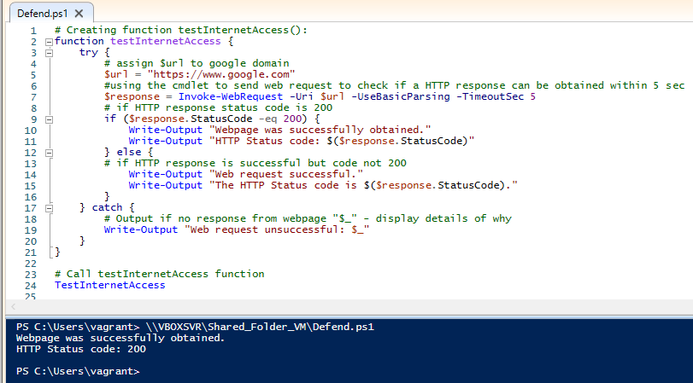
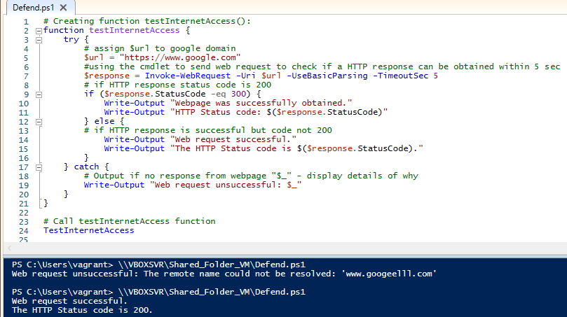
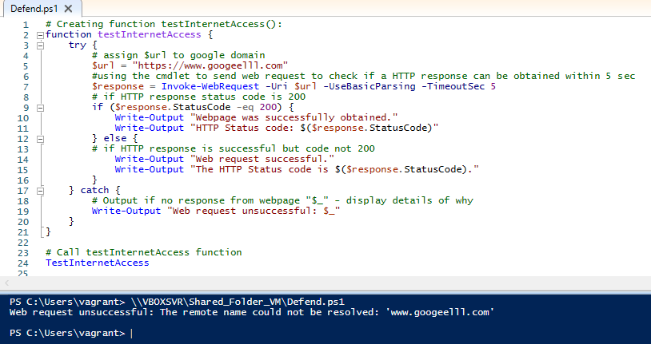
testInternetAccess():
Scenario 1: Tested ‘if statement’ on google domain - Successful
Scenario 2: Tested ‘else statement’ by setting if statement to 300 - Successful
Scenario 3: Tested ‘catch statement’ on non-existing domain - Successful

Slide 3
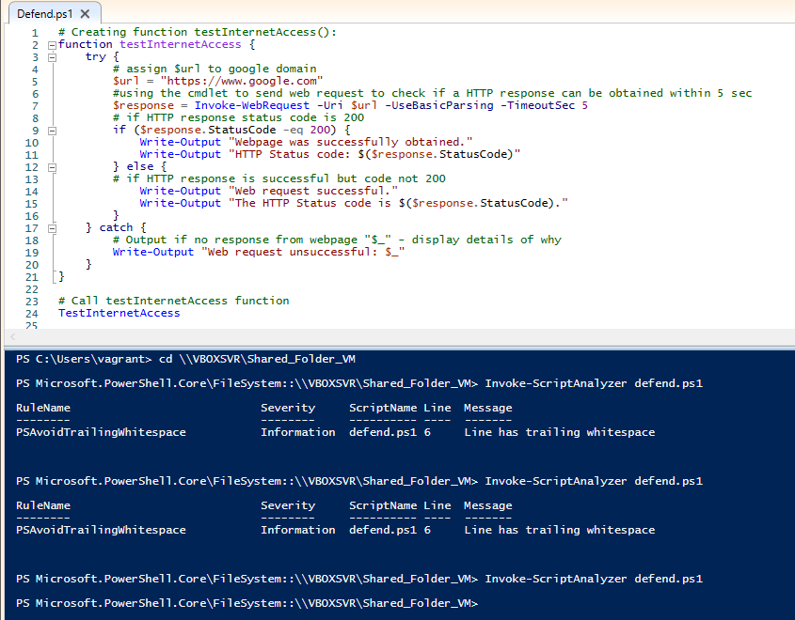
PSScriptanalyzer: Image showing that ‘invoke-scriptanalyzer’ was used to clean up code. As nothing was outputted in terminal, code is considered clean to psscriptanalyzer standard.

Slide 4
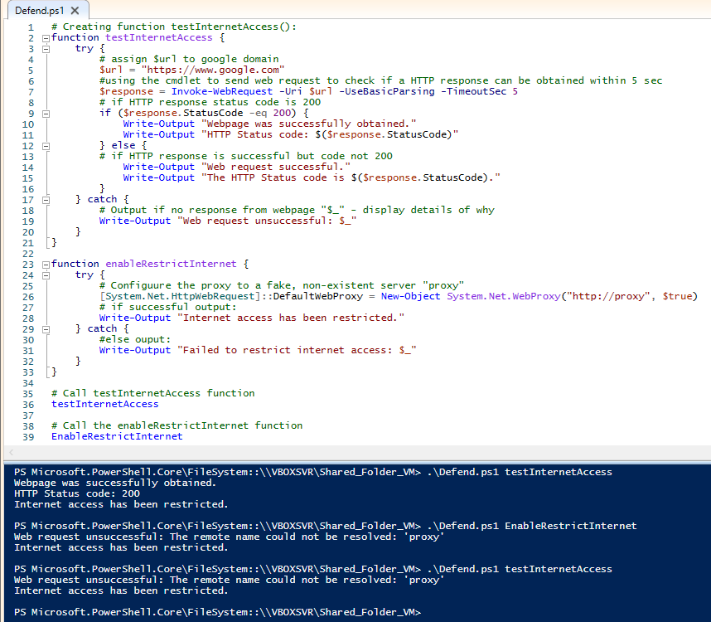
EnableRestrictionInternet(): Post-test
By testing the functions in this order:
1. TestInternetAccess
2. EnableRestrictInternet
3. TestInternetAccess we can see that the EnableRestrictInternet function is working as intended as after that function is run, we can see the ‘catch output’ of testInternetAccess

Slide 5

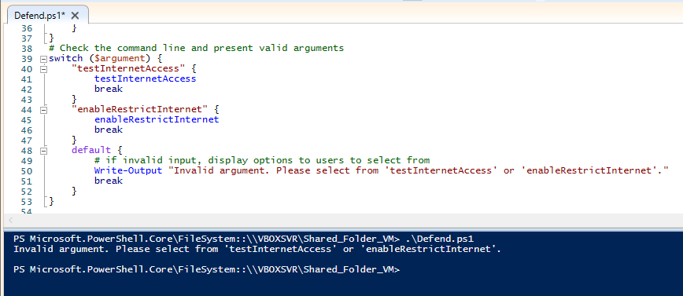
Set functions as arguments that could be selected

Slide 6
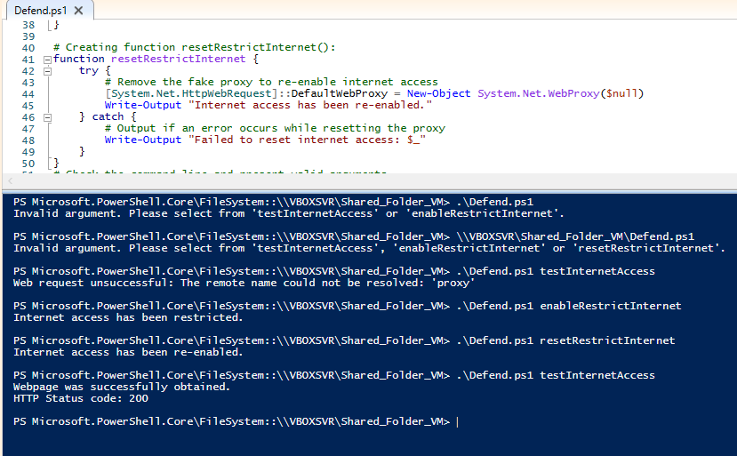
resetRestrictInternet():
By testing the functions in this order:
1. TestInternetAccess
2. EnableRestrictInternet
3. resetRestrictInternet
4. TestInternetAccess we can see that resetRestrictInternet function is working as insisted.

Slide 7
what i could do to improve your groupwork
As an adult with ADHD, I can implement strategies that Ph. D in psychology, Michele Novotni, has outlined in her “Group interaction at Work” article to improve my groupwork interactions.
Firstly, sitting down and outlaying the specific expectations that are set for every individual role within the group and consolidating the mutual understanding of the project, goals, and deadlines is paramount in groupwork interaction. By breaking down the project into smaller task will help me contribute effectively which I can tick off as I complete and help me remain focused on my role and task. Discussing the project scope should be done in a shared app where each member can access where tasks are documented concisely whilst all members are present to fairly distribute roles and responsibilities.
Secondly, another key step in group work is attending the group meetings and participate in the meeting itself by communicating with the team and keeping them updated with your progress and issues you may have in a timely manner (not as its due). I can achieve this by effectively managing my time, setting time aside to attend the meetings, use ADHD friendly timers to allocate focus time. Within meetings, I can use tools to help me retain important information and recall critical discussions such as recording meetings and note taking.
Teamwork, often seen as a soft skill a crucial skill in the workplace as you’ll have to collaborate with stakeholders, colleagues, and manager. The best way to develop it is by participation and interaction. By adhering to the strategies that Michele Novotni has mentioned, I can improve on my groupwork whilst dealing with the challenges of ADHD.

Slide 8
References:
14 reasons why teamwork is important in the workplace (2022) 14 Reasons Why Teamwork Is Important in the Workplace. Available at: https://au.indeed.com/career-advice/career-development/why-teamwork-is-important (Accessed: 28 August 2023).
Novotni, M. (2021) How to get along with the group, ADDitude. Available at: https://www.additudemag.com/group-interaction-at-work/#:~:text=Work%20Groups,to%20accomplish%20a%20task%20efficiently. (Accessed: 28 August 2023).

